Slide 1


Game Engines 1
3D Maths
Dr Bryan Duggan
DIT School of Computing
bryan.duggan@dit.ie
@ditcomputing
http://facebook.com/ditschoolofcomputing

Slide 2
Questions we will answer today
How do 3D graphics work?
How are co-ordinates represented?
What are vectors & angles and what have they got to do with each other?
How can I do useful stuff for games using trigonometry?
What can vectors be used for?
How do I rotate/scale/transform vectors?
How do I combine these operations?
How do you take a 3D scene and project onto a 2D screen?

Slide 3
Terminology
Polygon – a triangle in 3D Space
Vertex – a corner of a triangle (AKA point)
Texture – A bitmap “painted” onto a polygon
GPU – Graphics processing unit
Parallel “pipelines” for processing vectors & matrices

Slide 4
Originally…
Graphics memory was based on the
Resolution
Colour depth
Size of the pallet
Consider:
VGA 640 x 480 16 colour or 320×200 in 256 colors (Mode 13h) 256K (1987)
SVGA - 1024 × 768 256 colours

Slide 5
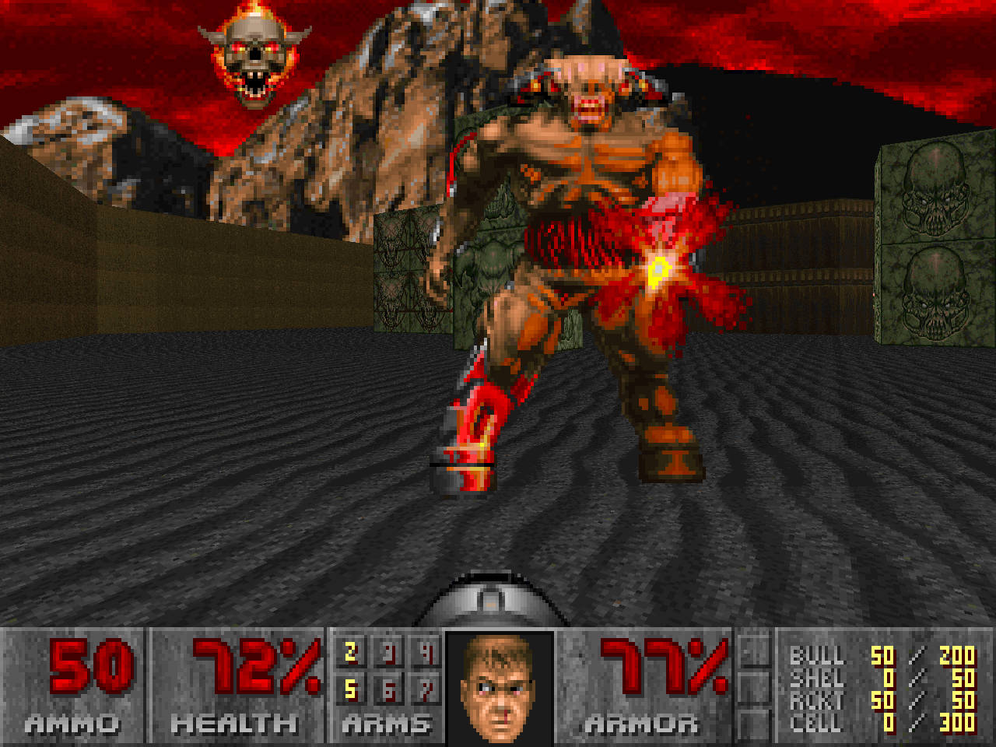

Slide 6
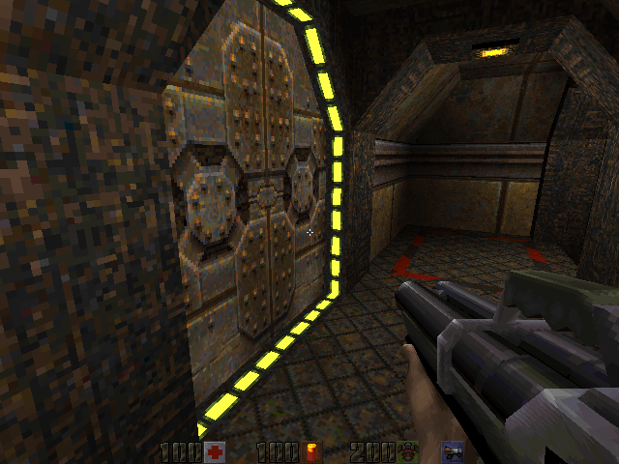

Slide 7
Now…
A graphics card does so much more in hardware!
Stores the 3D scene as a set of vertices
Vertices are composed into triangles & quads
Textures are drawn onto these
The scene is projected onto a 2D frame
Rasterisation is performed on the GPU
Lighting calculations are performed on the GPU
Fog, bump mapping, tessellation, HDR etc
Even physics & other general purpose parallelisable operations

Slide 8
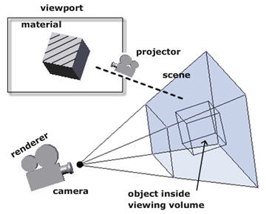
How do 3D Graphics work…

Slide 9
How it all works
We program a scene in 3D (specify the vertices, textures, lights etc.)
The graphics card takes care of rendering the scene.
Transforming the 3D world to a 2D image
This is done by the rendering pipeline

Slide 10
Co-ordinate Geometry
Y-Axis
Point
X-Axis
The Z-Axis extends from the front of the screen (+) to behind the screen (-)
This is a right handed co-ordinate system (OpenGL)
Z-Axis

Slide 11
Points
Y-Axis
Point
X-Axis
Points are represented by 3 numbers (x, y, z).
x = offset from 0 (origin) on the x axis,
y = offset from 0 (origin) on the y axis,
z = offset from 0 (origin) on the z axis
Z-Axis

Slide 12
Pythagoras
H² = A² + O²
Sin θ = O / H
Cos θ = A / H
Tan θ = O/A
Sin ⁻¹ (O/H) = θ
Cos ⁻¹ (A/H) = θ
Tan ⁻¹ (O/A) = θ
H
O
θ
A

Slide 13
Angles
Keep in mind!
Where you are starting from (where is 0)
The direction (cw/ccw)
Some functions expect degrees, some expect radians:
glm::degrees();
glm::radians();

Slide 14
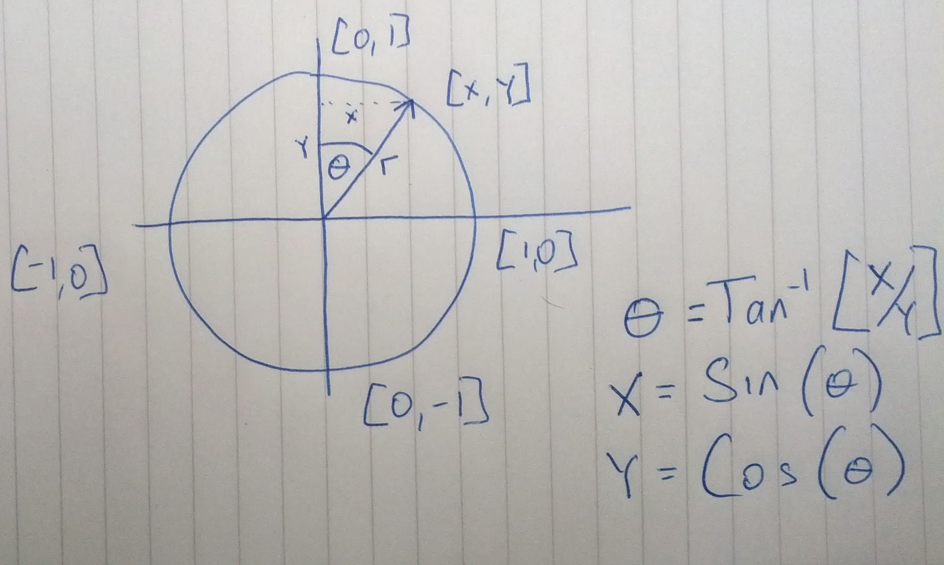

Slide 15
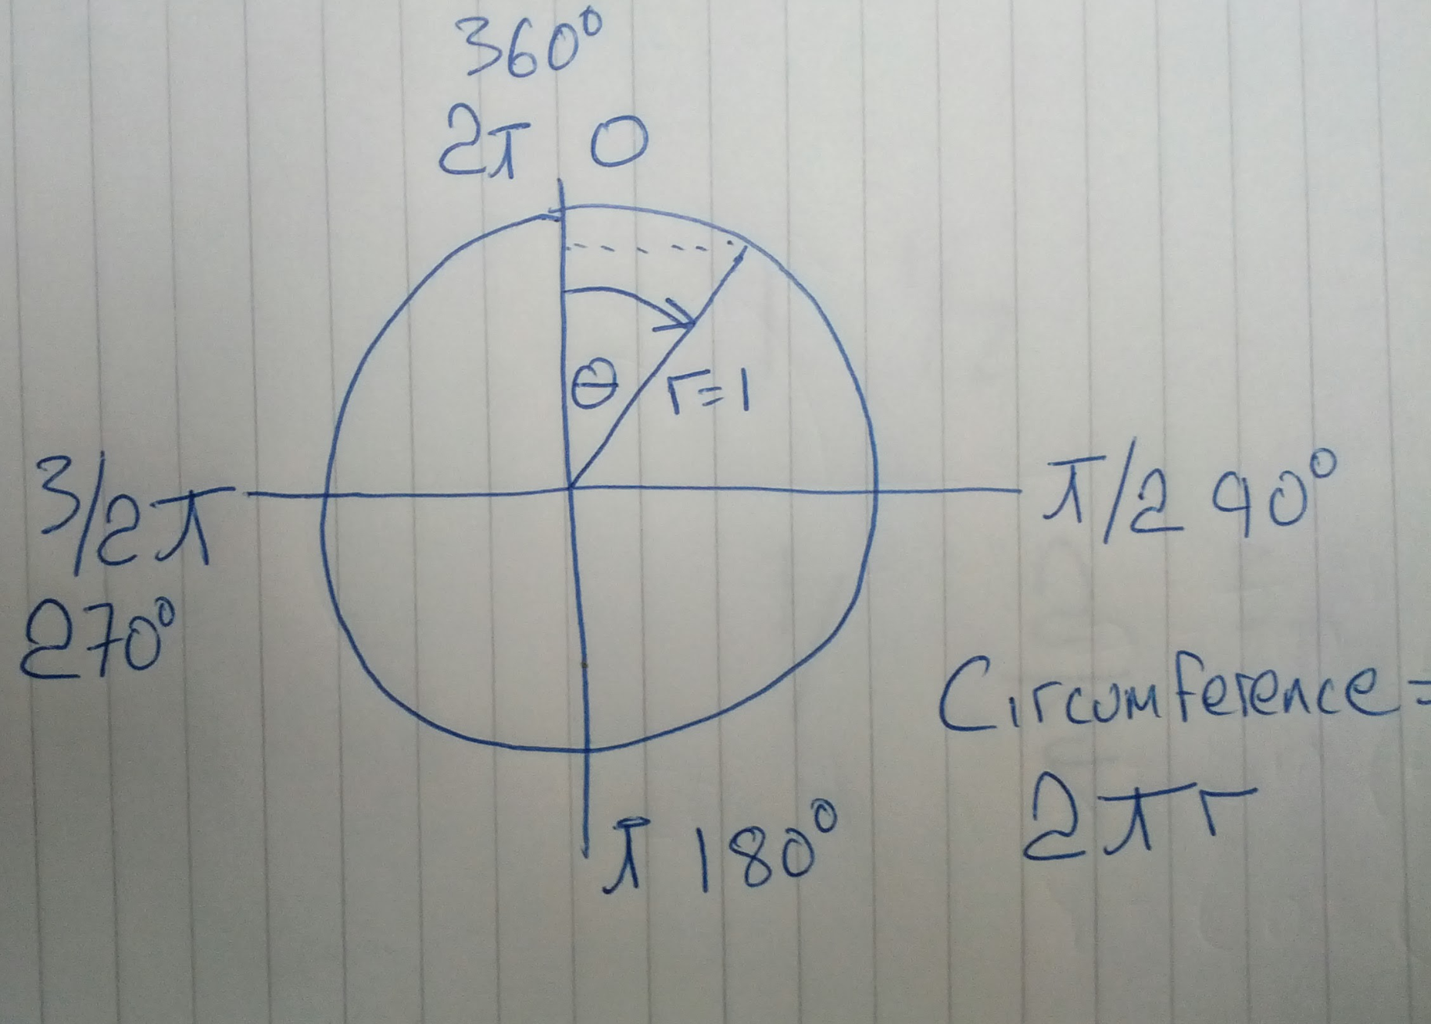

Slide 16
We will use GLM
Header only C++ mathematics library for graphics software based on the OpenGL Shading Language (GLSL)
Released under the MIT license.
Lots of template classes/methods
An extension system provides extended capabilities:
matrix transformations
Quaternions
Random number generation
Procedural noise functions, etc.

Slide 17
GLM
#include<glm.hpp>
#include <gtc/matrix_transform.hpp>
#include <gtc/quaternion.hpp>
Never use:
using namespace glm:
Instead use glm::
glm::sin, glm::cos, glm::tan, glm::acos, glm::asin, glm::atan
Optional template parameter! E.g:
glm::sin<float>()

Slide 18
glm::vec3
In DirectX we use the:
glm::vec3 struct to represent a point
A vector has
x,y,z
Origin
Magnitude
Therefore it can also be used to represent:
Velocity
Force
Heading
Lots of things - even a colour! (x=r, y=g, z=b)
A vector with a magnitude of 1 is called a unit vector
BTW there are glm::vec2 and glm::vec4’s as well if you need them

Slide 19
glm::vec3
Operators =, +, - *, / are overloaded
Two vectors are = if same direction and same length (x, y, z are the same)
Construct using one param constructor:
glm::vec3 position = glm::vec3(0);

Slide 20
Polar to Cartesian conversions
R=Sqrt(x²+y²);
Theta=ArcTan(Y/X);
X= R*cos(Theta)
Y= R*sin(Theta)

Slide 21
Adding & Subtracting Vectors
Commutative Law for Addition:
A + B = B + A
Associative Law for Addition:
A + (B + C) = (A + B) + C
Commutative Law for Multiplication:
mA = Am
Associative Law for Multiplication:
(m + n)A = mA + nA, where m and n are two different scalars.
Distributive Law:
m(A + B) = mA + mB

Slide 22
Magnitude of a Vector
The magnitude of a vector V = (v₁,v₂,v₃)^{T} is given by:
|V| = sqrt(v₁*v₁ + v₂*v₂ + v₃*v₃)
eg (1,2,3)^{T} has magnitude sqrt(14)
Use:
glm::length(v)
To calculate the length (magnitude) of a vector
Notes:
21
21

Slide 23
Normalising a vector
To make the length 1 (a unit vector)
A unit vector in the direction of V is
^ V / |V|
Divide each component by the length
Or use:
v2 = glm::normalise(v1)
v1 DOES NOT get changed by the operation

Slide 24
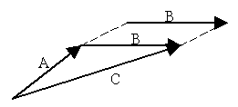
Vector addition
To add vectors, add the components
Both vectors must be of the same dimension
u + v = (u_{x} + v_{x}, u_{y} + v_{y}, u_{z} + v_{z})
Use the overloaded + operator

Slide 25
Vector Subtraction
To subtract 2 vectors, add the components
Both vectors must be of the same dimension
u - v = (u_{x} - v_{x}, u_{y} - v_{y}, u_{z} - v_{z})
Use the overloaded - operator

Slide 26
Scalar Multiplication
Multiply each component by a scalar
“Scales” the vector
Use the overloaded * operator

Slide 27
“Dot” product
“Multiply” 2 vectors together
u.v = (u_{x} v_{x} + u_{y} v_{y} + u_{z} v_{z})
u.v = |u||v|cos θ
Or cos θ = u.v / |u||v|
I.e. The cosine of the angle between them scaled by the vectors magnitude
For unit vectors, u.v = cos θ!
THIS IS INCREDIBLY USEFUL PROPERTY!

Slide 28
Interesting properties
If u.v = 0, then u v - Cos (PI/2) = 0
If u.v > 0, then θ > PI/2
If u.v < 0, then θ > PI/2
Use glm::pi<float>() to get PI
Use
float glm::dot(a, b)
To calculate

Slide 29
Dot product uses:
Dot product will be positive if an entity is in front of the entity
Orientation Vector
+
-

Slide 30
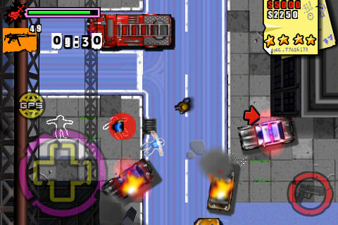
Consider…
Entity B
Entity A

Slide 31
Also…
Use the dot product to calculate angle of offset to opponent,
If angle > (FOV/2), then the opponent is inside the FOV!
Field of view
+
-

Slide 32
Cross product
Evaluates to another vector that is mutually perpendicular to the two vectors
p = u x v = (u_{y} v_{z} - u_{z} v_{y}, u_{z} v_{x} - u_{x} v_{z,} u_{x} v_{y} - u_{y} v_{x})
In code:
glm::vec3 a = glm::cross(b, c);
Axis of rotation
We can use this to find “normals” of planes/triangles

Slide 33
For more on vectors and trigonometry, see
http://www.physics.uoguelph.ca/tutorials/vectors/vectors.html

Slide 34
Matrix
Matrix - a rectangular array of numbers arranged into rows and columns. A matrix with m rows and n columns can be written as:
Rows,
i = 1, …, m
Columns,
j = 1, …, n

Slide 35
Examples
These are valid matrices
These have problems

Slide 36
Row and Column Matrices (vectors)
row matrix (or row vector) is a matrix with one row, i.e., the dimension m = 1
column matrix is a matrix with only one column

Slide 37
Square Matrix
When the row and column dimensions of a matrix are equal (m = n) then the matrix is called square

Slide 38
Matrix Equality
Two (m x n) matrices A and B are equal if and only if each of their elements are equal. That is
A = B
if and only if
a_{ij} = b_{ij} for i = 1,...,m; j = 1,...,n

Slide 39
Matrix Addition

Slide 40
Examples - Matrix Addition
The following matrix addition is not defined

Slide 41
Scalar – Matrix Multiplication
Multiplication of a matrix A by a scalar is defined as
Examples

Slide 42
Identity Matrix
Identity Matrix
The identity matrix has the property that if A is a square matrix, then

Slide 43
Matrix – Matrix Multiplication
The product of two matrices A and B is defined only if
the number of columns of A is equal to the number of rows of B.
If A is (m x p) and B is (p x n), the product is an (m x n) matrix C

Slide 44
Matrix-Matrix Multiplication
The product AB is obtained as follows:
To obtain the 1,1 entry of AB, multiply Row 1 of A by Column 1 of B.
To obtain the 1,2 entry of AB, multiply Row 1 of A by Column 2 of B.
To obtain the 1,3 entry of AB, multiply Row 1 of A by Column 3 of B. . . .
To obtain the 2,1 entry of AB, multiply Row 2 of A by Column 1 of B.
To obtain the 2,2 entry of AB, multiply Row 2 of A by Column 1 of B. and so on.
In general,
To obtain the i,j entry of AB, multiply Row i of A by Column j of B.
Note: The product AB has as many rows as A and as many columns as B.

Slide 45
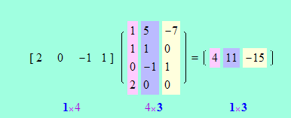
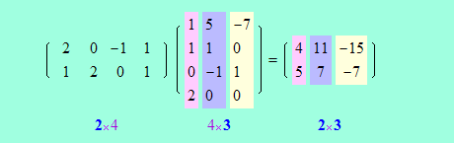
Examples

Slide 46
Tutorial
General Matrix Operations
http://www.zweigmedia.com/RealWorld/tutorialsf1/frames3_2.html
OpenGL Matrix/Tutorial
http://www.opengl-tutorial.org/beginners-tutorials/tutorial-3-matrices/

Slide 47
Transformations
Why are you confusing us with all this stuff?
Because you can use matrices to do transformations
Translations
Rotations
Scaling

Slide 48
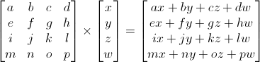
In OpenGL we usually…
Use 4 x 4 matrices
Use the glm::mat4 class to represent a 4 x 4 matrix
Use 1 for the 4th element of the vector matrix
Multiply vectors by matrices
To do transformations
Multiply matrices by matrices
To combine transformations

Slide 49
Translation matrix
To translate a vector
x units on the x axis
y units on the y axis
z units on the z axis
Multiply the vector by the following matrix:
Use:
glm::mat4 m = glm::translate(glm::mat4(1), position);

Slide 50
Rotation
http://www.cs.princeton.edu/~gewang/projects/darth/stuff/quat_faq.html
To rotate a vector
θ Radians in an ANTI-clockwise direction looking down axis
To make the rotation matrix use:
glm::mat4 rotMatrix = glm::rotate(glm::mat4(1), theta, glm::vec3(0,1,0));
Matrix to rotate
(In this example,
the identity)
Angle of rotation
Axis of rotation

Slide 51
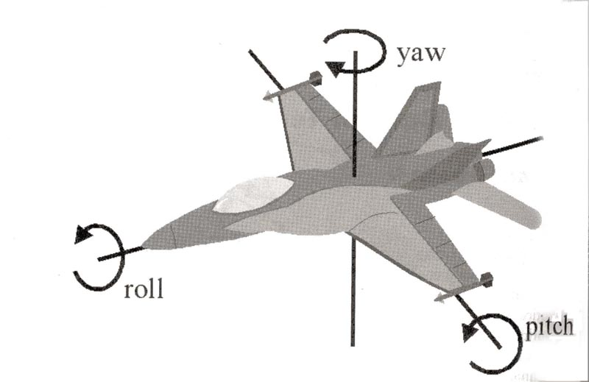
“Special” rotations

Slide 52
Scaling matrix
To scale a vector
x units on the x axis
y units on the y axis
z units on the z axis
Multiply the vector by the following matrix:
glm::mat4 scale = glm::scale(glm::mat4(1), scale)

Slide 53
Combining Transformations
We can combine transformations together by multiplying the matrices together to get a single transformation matrix
This means we can apply the same transformations to the multiple vectors
The order that you multiply is the order the transformations are carried out!!!

Slide 54
The CORRECT way!
glm::mat4 myModelMatrix = myTranslationMatrix * myRotationMatrix * myScaleMatrix;
glm::vec4 myTransformedVector = myModelMatrix * myOriginalVector;
If you have a vec3 (which is normal)
You must make a vec4 out of it
You get a vec4 back
And then make a vec3 from the result:

Slide 55
Consider:
glm::mat4 trans = glm::translate(glm::mat4(1), position) * glm::scale(glm::mat4(1), scale);
glm::vec4 point0, point1;
point0 = trans * glm::vec4(lines[i], 1);
point1 = trans * glm::vec4(lines[i + 1], 1);
LineDrawer::DrawArrowLine(glm::vec3(point0), glm::vec3(point1), colours[i / step], arrowOrientations[i / step]);

Slide 56
Some final year project ideas
An African Safari Oculus Rift experience. Unity or UDK. Focus here would be on developing animal AI models
A first person driving tutor using Oculus Rift, with simulated pedestrians, cars, cyclists etc.
A cell’s eye view of some process going on inside the human body. Possibly a game about this. (Probably Unity)
A boids eye view flocking simulation - Imagine being a bird flying in the middle of a flock of birds. Could use Kinect to control your bird avatar.
Using Esri city map to map dublin and provide an experience of flying over the city
MonoGame integration and code examples for the Oculus Rift
Using leap motion to simulate a potters wheel
A remake of Magic Carpet using Kinecxt & Rift
A 2D/3D port of any number of classic Mastertronic games from the 80's - Strorm, Octagon Squad, Terminus, Chiller,
http://www.worldofspectrum.org/infoseekid.cgi?id=0003484
http://www.youtube.com/watch?v=l8uXO71fBGA
http://www.youtube.com/watch?v=17q4pR-hcTE
http://www.youtube.com/watch?v=utcWV9jEkXE
http://www.irishtimes.com/news/watch-eagle-in-flight-video-proves-youtube-hit-1.1531838

